Slide 1
Logic Families

Slide 2
Objectives
At the end of this lecture, student will be able to:
Acquire the knowledge of logic device pin-outs
Explain gate characteristics
Describe transistors as switches

Slide 3
Lecture 27 Transistors as switches
Lecture delivered by:
Deepak V.

Slide 4
Topics
Logic device pin-outs
Transistors as switches
Rise and fall times
Schottky Transistors

Slide 5
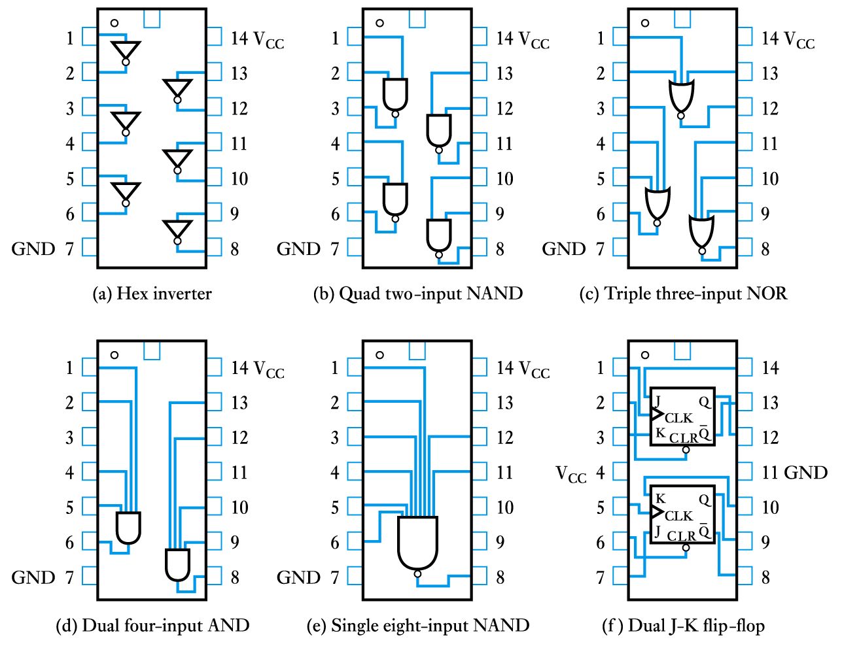
Typical logic device pin-outs

Slide 6
Transistors as switches
Both FETs and bipolar transistors make good switches
Neither form produce ideal switches and their characteristics are slightly different
Both forms of device take a finite time to switch and this produces a slight delay in the operation of the gate
This is termed the propagation delay of the circuit

Slide 7
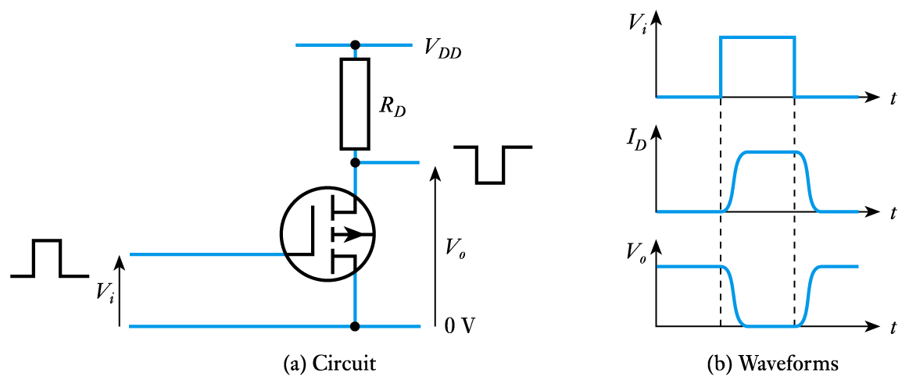
The FET as a logical switch

Slide 8
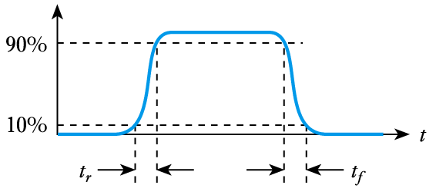
Rise and fall times
Because the waveforms are not perfectly square we need a way of measuring switching times
We measure the rise time, t_{r} and fall time, t_{f} as shown below

Slide 9
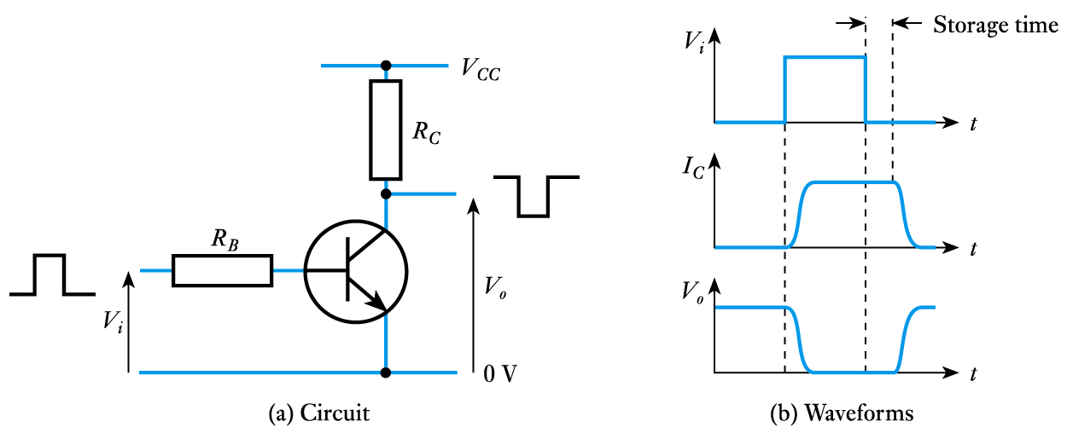
The bipolar transistor as a logical switch

Slide 10
The bipolar transistor as a logical switch
When the input voltage to a bipolar transistor is high the transistor turns ON and the output voltage is driven down to its saturation voltage which is about 0.1 V
However, saturation of the transistor results in the storage of excess charge in the base region
This increases the time taken to turn OFF the device – an effect known as storage time
This makes the device faster to turn ON than OFF
Some switching circuits increase speed by preventing the transistors from entering saturation

Slide 11
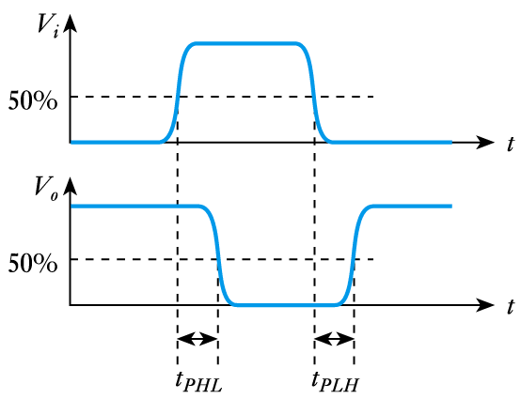
Timing considerations
All gates have a certain propagation delay time, t_{PD}
This is the average of the two switching times

Slide 12
Schottky Transistors
Addition of Schottky diodes between base and collector prevent saturation
Schottky diode has lower forward bias voltage drop (0.25 v).
Resulting design is called a Schottky transistor
Speeds switching time by reducing charge storage in saturation

Slide 13
Summary
Unlike linear amplifiers, the circuits is used with a rapid transition between the non-linear regions
Both FETs and bipolar transistors make good switches
Some switching circuits increase speed by preventing the transistors from entering saturation

